Slide 1


Flight Operations Difficulty Analysis - United Airlines
Team name : AIRLYTICS
Team members : 1. AMAN SINGH (LEADER)
2. AAKRATI GUPTA
(NATIONAL INSTITUTE OF TECHNOLOGY, KURUKSHETRA)

Slide 2
Objective: To analyze flight operations and develop a data-driven ‘Flight Difficulty Score’ that identifies operationally challenging flights.
Deliverables:
Exploratory Data Analysis (EDA)
Flight Difficulty Score Development
Post-Analysis & Operational Insights

Slide 3
Datasets Used: 1. Flight Level Data 2. PNR Flight Level Data 3. PNR Remark Level Data 4. Bag Level Data 5. Airport Information Key Variables: Delay, Ground Time, Passenger Load, Bag Type, SSR Requests

Slide 4
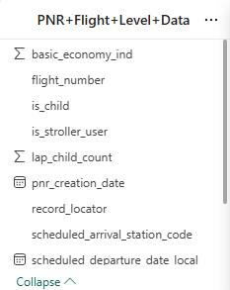
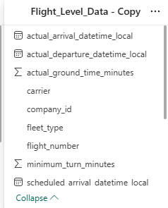
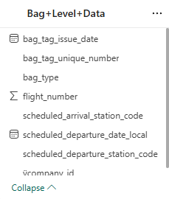
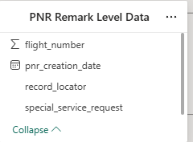
Columns and key metrics from each dataset

Slide 5
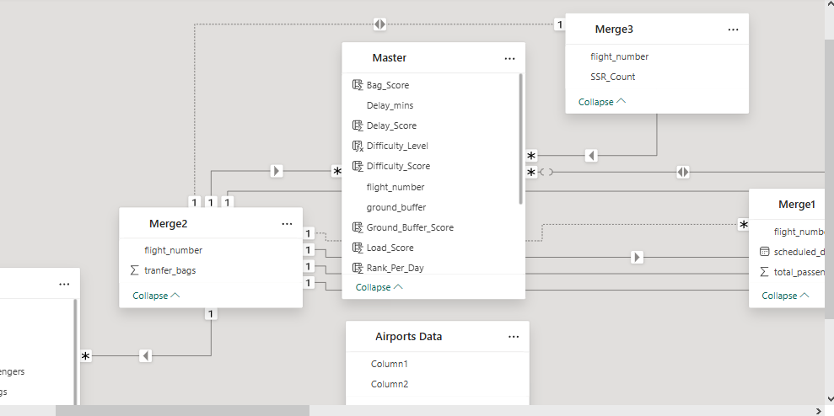
Merging & Cleaning Process in Power BI
Merged data using flight_number & scheduled_departure_date_local
Grouped and counted passengers, bags, and SSR requests
Created master flight-level table

Slide 6
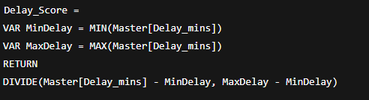
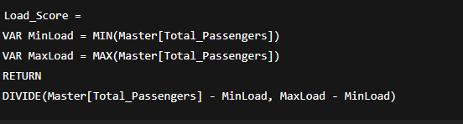
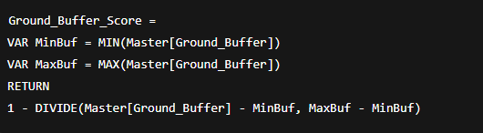
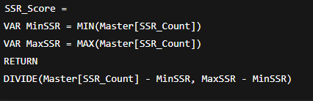
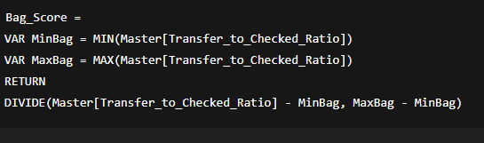
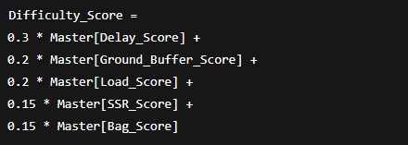
New Columns Created Using DAX

Slide 7
Exploratory Data Analysis (EDA) Key Questions Answered: 1. Average delay and % of late departures 2. Flights with low ground time vs minimum turn time 3. Ratio of transfer vs checked (origin) bags 4. Passenger load and correlation with difficulty 5. SSR flights and their delay trends

Slide 8
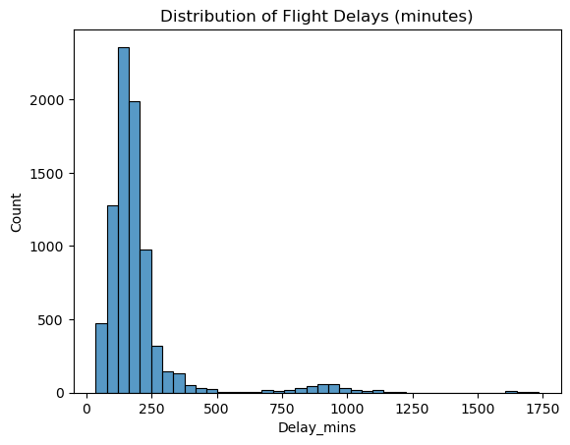
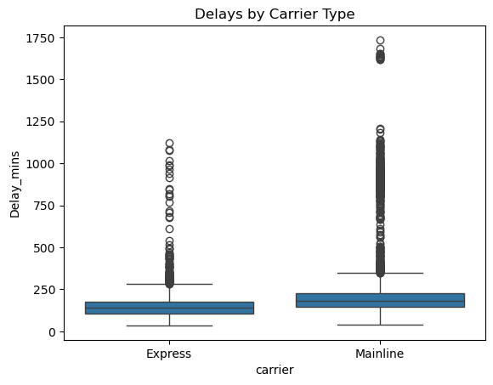
Insights From EDA
avg_delay = flights["Delay_mins"].mean()
print("Average Delay (min):", avg_delay)
Average Delay (min): 197.9344363501667

Slide 9
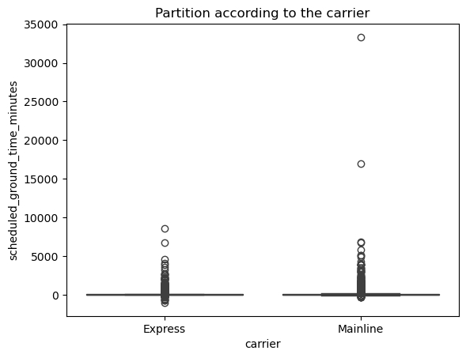
short_ground = (flights["scheduled_ground_time_minutes"] <= flights["minimum_turn_minutes"]).sum()
print("Flights with short/insufficient ground time:", short_ground)
Flights with short/insufficient ground time: 652

Slide 10
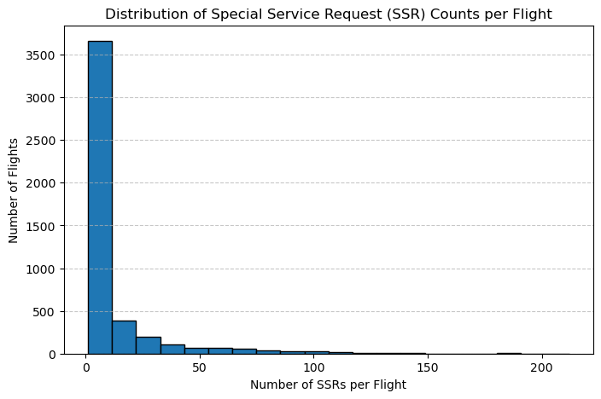
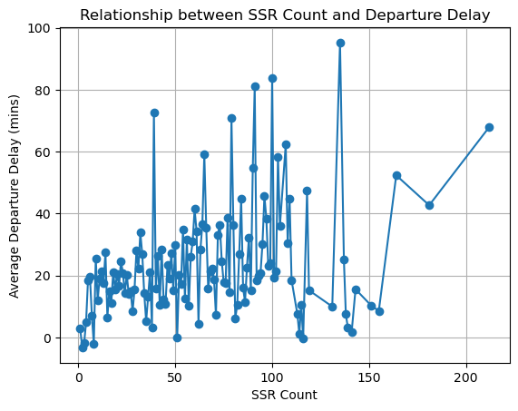
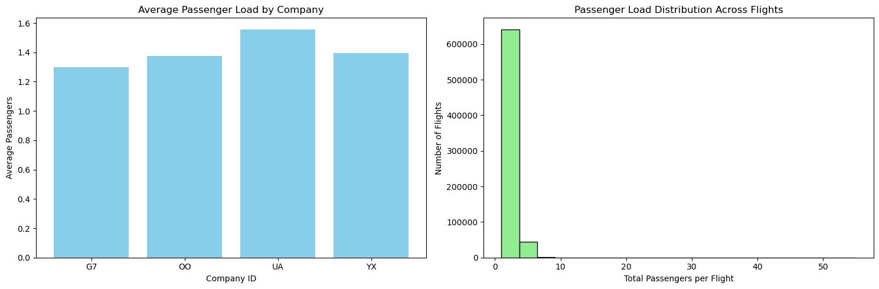

Slide 11
Flight Difficulty Score Development Steps Taken: 1. Combined all data sources into one master flight-level table. 2. Identified difficulty factors: ~ Delay (↑ harder) ~ Ground Buffer (↓ harder) ~ Transfer Bag Ratio (↑ harder) ~ Passenger Load (↑ harder) ~ SSR Count (↑ harder) 3. Normalized all values (0–1 scale) 4. Computed weighted difficulty score 5. Ranked & classified flights (Easy / Medium / Difficult)

Slide 12
Insights & Findings 1. Overall Flight Difficulty Distribution Majority of the flights fall under the “Difficult” category (≈56.8K Difficulty Score) compared to Medium (8.7K) and Easy (0.6K). Indicates a significant operational challenge in maintaining on-time performance. 2. Difficulty by Airline (company_id) Airline G7 and OO show the highest difficulty scores, followed by UA and YX. This may be due to route complexity, higher load factors, or lower ground buffer time.

Slide 13
3. Ground Buffer vs Flight Difficulty The Sum of ‘ Difficulty Score vs Ground Buffer’ chart shows that flights with lower ground buffer minutes (0–10 mins) have higher difficulty scores. Suggests tight turnaround times significantly impact flight performance and increase delay risk. 4. Airport Pair Trends Routes originating from ORD (Chicago O’Hare) appear frequently in the table, suggesting it’s a high-traffic and high-difficulty hub. ORD shows high difficulty possibly due to congestion or shorter ground time windows. .

Slide 14
5. Temporal Trends The 2025 flight data shows a higher proportion of difficult flights compared to easy or medium, indicating a rising operational challenge in recent schedules

Slide 15
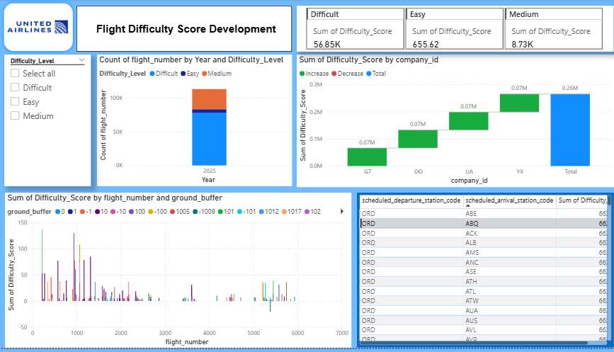
Dashboard

Slide 16
Recommendations 1. Increase Ground Time for High-Difficulty Routes Add at least +5 to +10 minutes of buffer for ORD-based routes and those with high SSR (Special Service Requests) counts. Reduces turnaround stress and minimizes cascading delays. 2. Focus Operational Improvements on G7 and OO Airlines Prioritize maintenance efficiency, gate management, and baggage handling for these carriers to bring down overall difficulty. .

Slide 17
3. Dynamic Scheduling & Predictive Planning Use the developed Flight Difficulty Score model to forecast high-risk flights daily and allocate resources (ground crew, gates, equipment) accordingly. 4. Airport Collaboration Collaborate with ground staff at ORD and other high-difficulty airports to streamline loading/unloading and improve on-time performance.

Slide 18
5. Continuous Monitoring Integrate this Difficulty Score dashboard into regular operations to track progress monthly and measure if interventions reduce difficulty trends.

Slide 19
Conclusion 1. Developed a daily-level Flight Difficulty Score model to assess operational performance. 2. Identified that low ground buffer times and high SSR (special service requests) are major contributors to flight difficulty. 3. Observed that some airlines and routes consistently experience higher operational difficulty. 4. Highlighted the importance of optimizing turnaround processes and improving resource allocation at critical airports. 5. Demonstrated how data-driven insights can enhance efficiency, on-time performance, and passenger satisfaction. Tools Used: Power BI, DAX, Excel/Python

Slide 20
Thank you!

